Slide 1
Crop Recommendation
MT2023195 Nisha Rathod
MT2023165 Somya Malgudi
MT2023030 Akshansh Jain

Slide 2





Purpose: AI based crop recommendation to farmers
Pain Areas: Choosing the right crop for the right soil is the key for good harvest but farmers use the conventional practices. We recommend right crop based on soil condition, rainfall, vegetation, rotation practices etc.
Data Points: Vegetation data, season temperatures, rainfall data, terrain data, ratings for crop rotation.
Technology: ML models will analyze the farm conditions along with the terrain data to identify the best suited crop for farming.
Business Outcomes: Higher produce of good quality and less chances of crop failures.

Slide 3
Data Generation

Slide 4
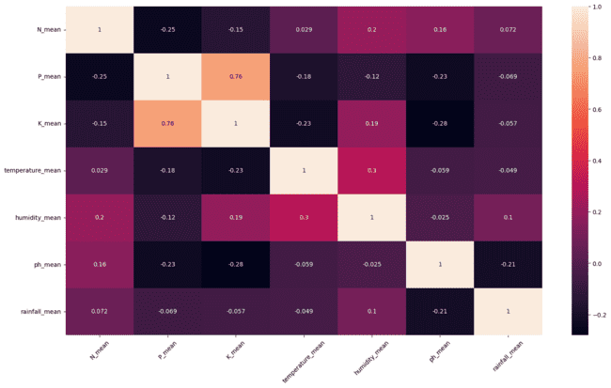
We had 22 crops in our dataset, to generate more crops we first found correlation between columns.
Now to make cohorts we found a threshold using IQR (0.29) and noticed that out data 2 cohorts.
Cohort 1: K_mean, P_mean
Cohort 2: humidity_mean, temperature_mean
Now we fixed value of one of the columns from each cohorts and predicted for the other using Linear Regression.
We have total for 100 local crops and 20 imported crops in our dataset now, and flexibility to increase this as much as we want!

Slide 5
Content Based + MAB

Slide 6
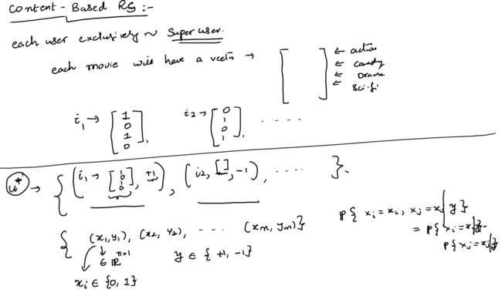
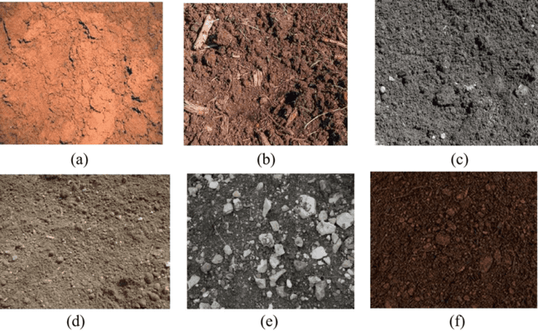
Content Based
Ref:. Lecture 9

Slide 7
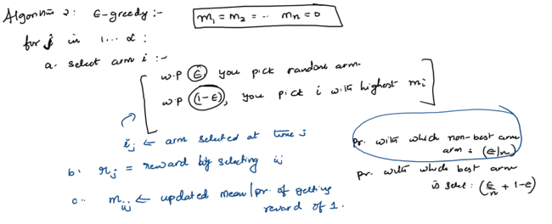
ε-greedy
Ref:. Lecture 12

Slide 8
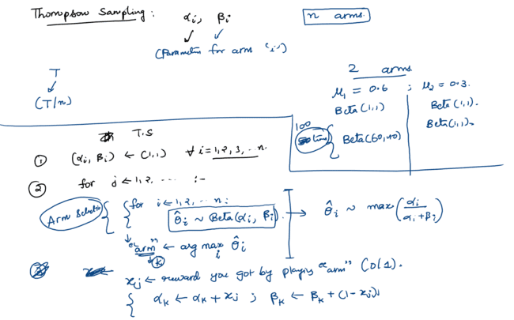
Thompson’s Sampling
Ref:. Lecture 15

Slide 9
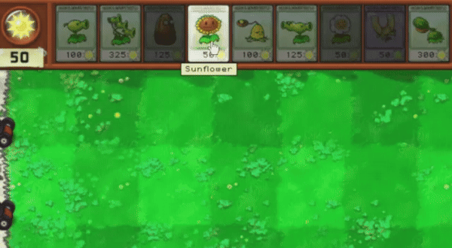
What to plant? → Content Based

Slide 10
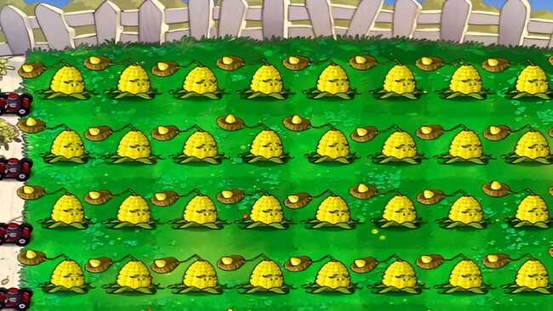
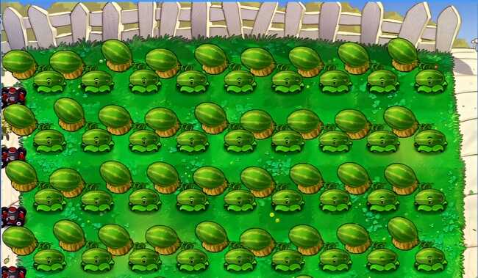
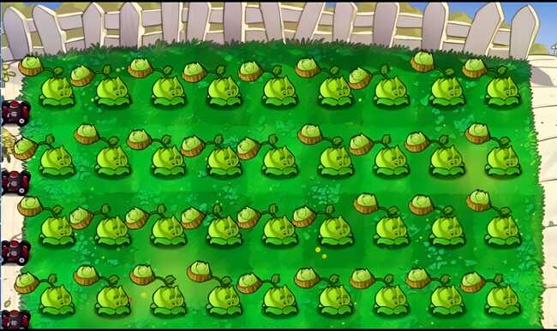
Crop Rotation → MAB

Slide 11
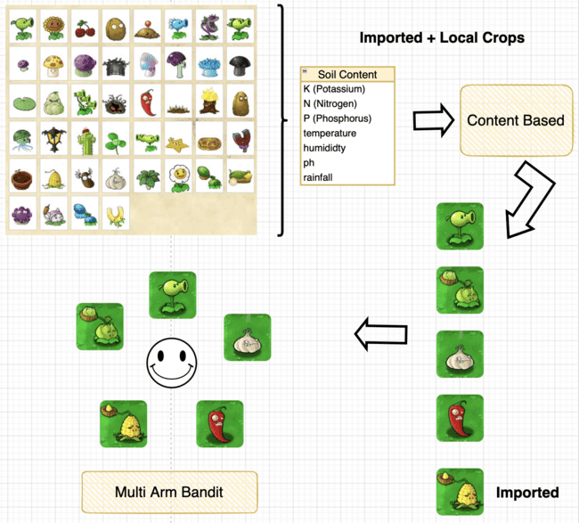

Slide 12
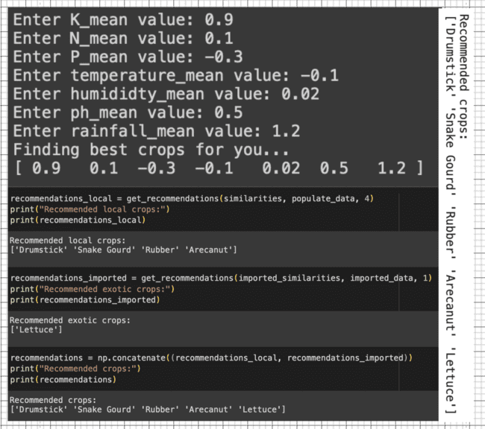
Content Based
Awesome now we have 5 most suited crops

Slide 13
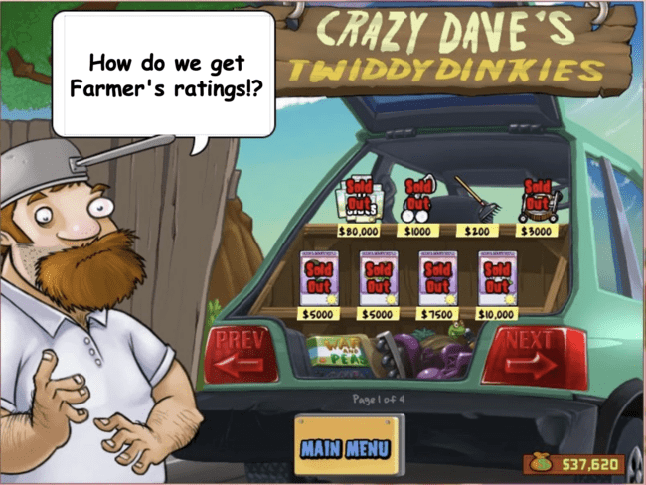
Wait! Before starting with MAB

Slide 14
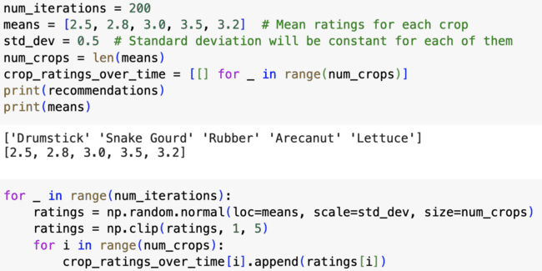
We are assuming that ratings follow normal distribution

Slide 15

Loading ε-greedy
Skipping Boring code stuff for you…

Slide 16
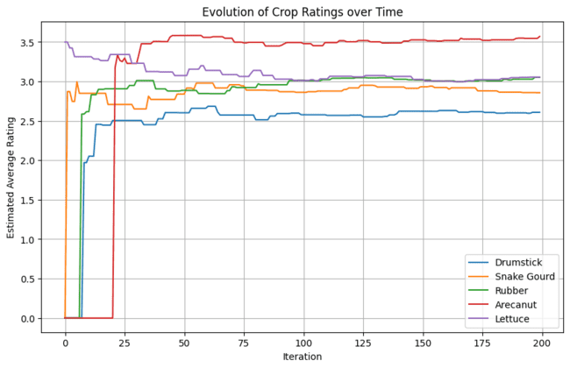
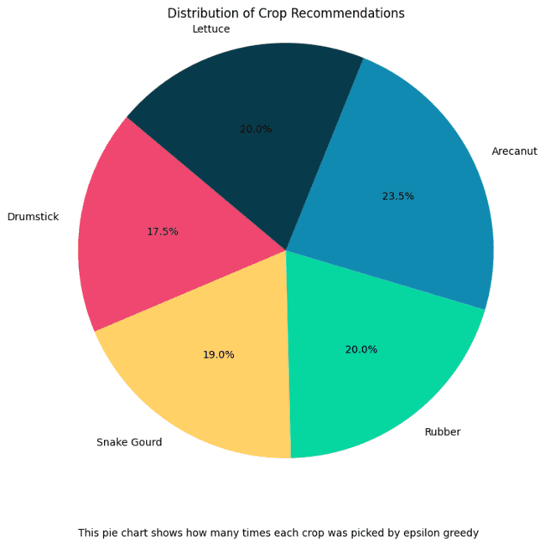
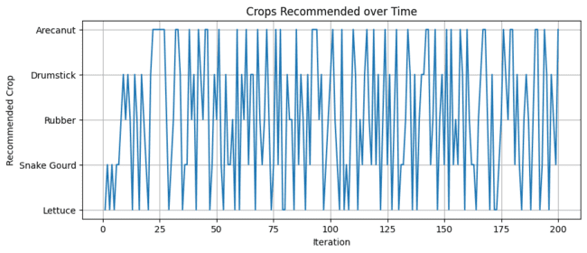
['Drumstick' 'Snake Gourd' 'Rubber' 'Arecanut' 'Lettuce']
epsilon = 0.3
num_iterations = 200
means = [2.5, 2.8, 3.0, 3.5, 3.2]
std_dev = 0.5
Output dump

Slide 17
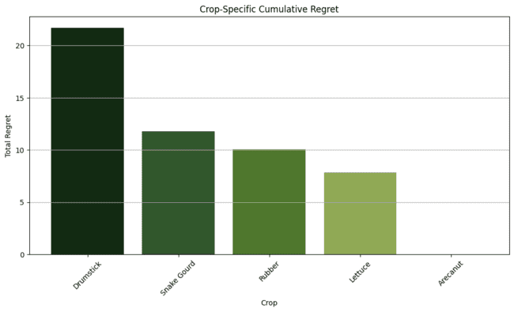
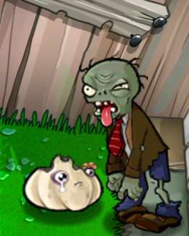
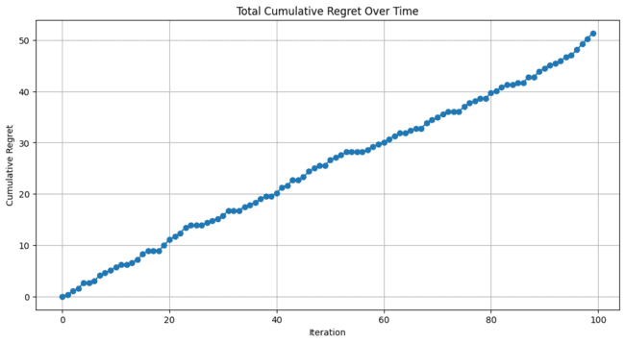
Regret Analysis

Slide 18
Loading Thompson's Sampling
Skipping Boring code stuff for you…

Slide 19
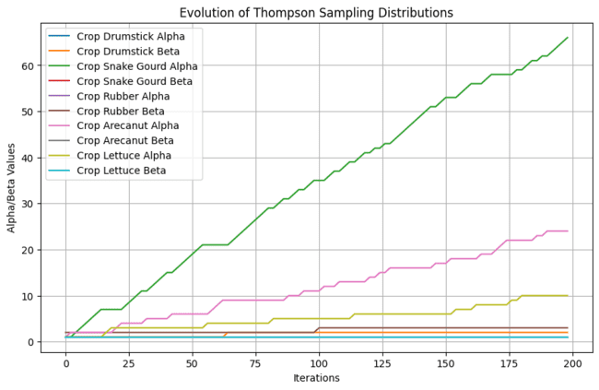
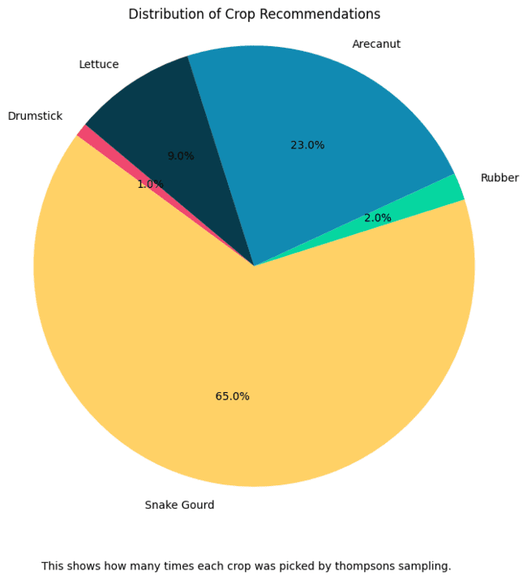
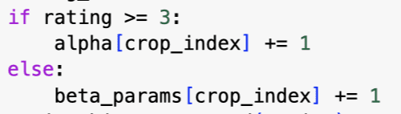
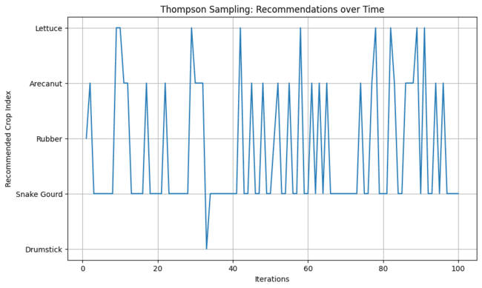
['Drumstick' 'Snake Gourd' 'Rubber' 'Arecanut' 'Lettuce']
Output dump 2.0
epsilon = 0.3
num_iterations = 200
means = [2.5, 2.8, 3.0, 3.5, 3.2]
std_dev = 0.5

Slide 20
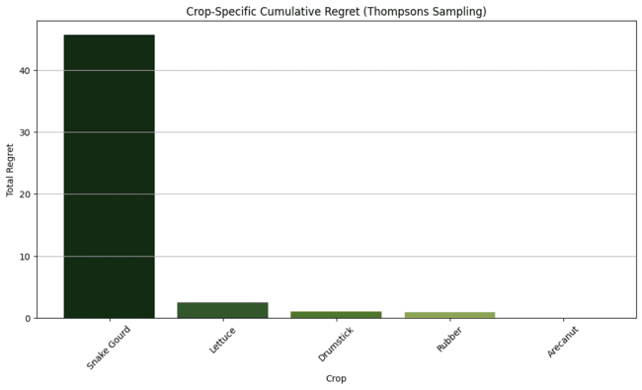
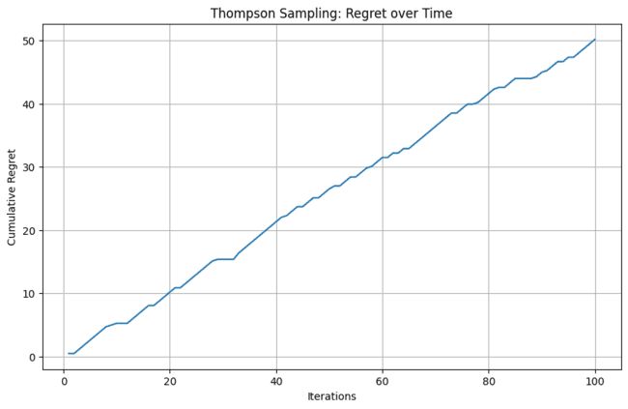
Regret Analysis 2.0

Slide 21
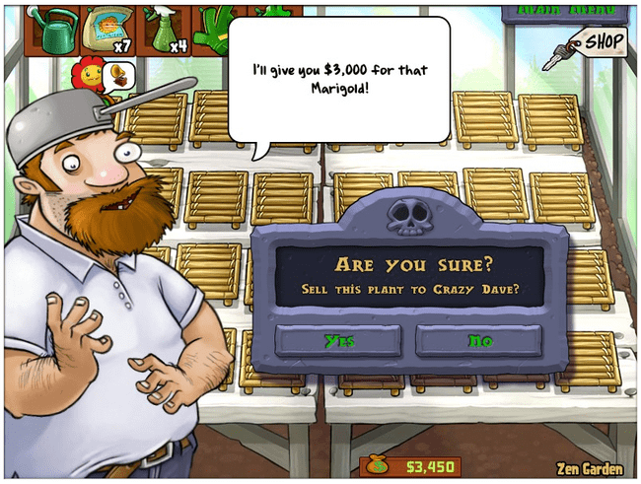
Oops but we didn't consider farmers budget in this algorithm

Slide 22
Resolving
Fetching interesting stuff for you…

Slide 23
Linear UCB

Slide 24
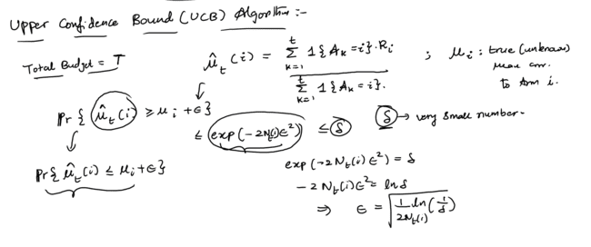
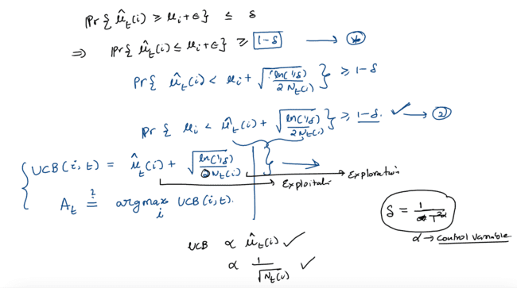

UCB
Ref:. Lecture 14

Slide 25
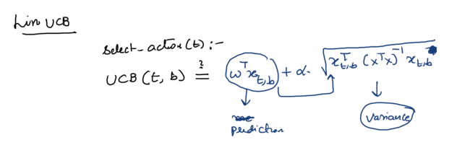
Linear UCB
Ref:. Lecture 16

Slide 26

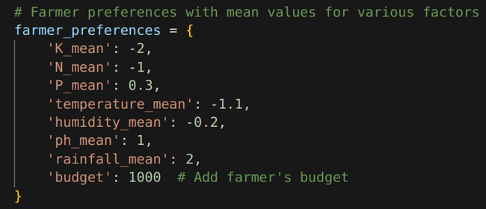
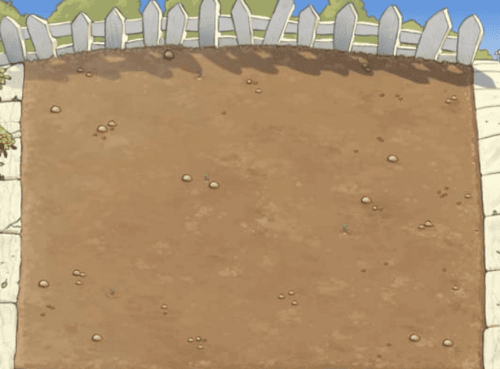
Farmers Input
The goal is to maximize the cumulative reward obtained by the farmer over a series of crop selections, taking into account both the estimated rewards and uncertainties associated with each crop.

Slide 27
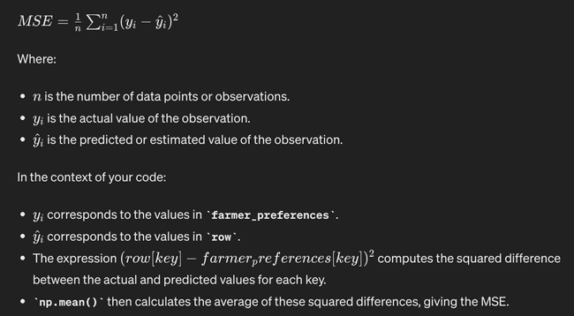

Initial Rewards

Slide 28

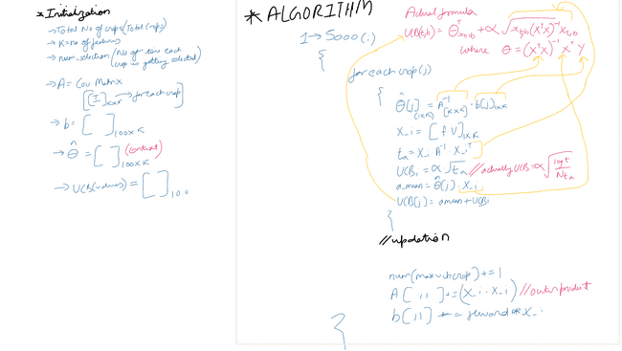
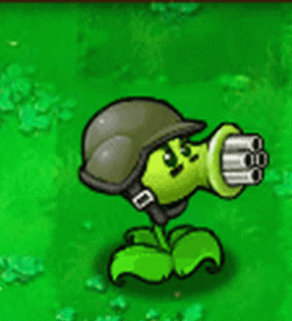
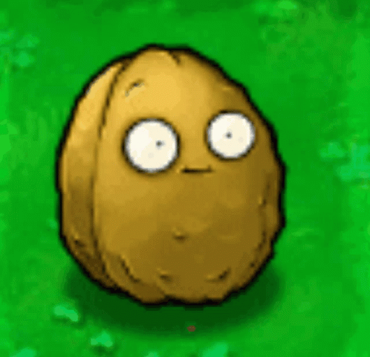
Linear UCB for a single farmer

Slide 29
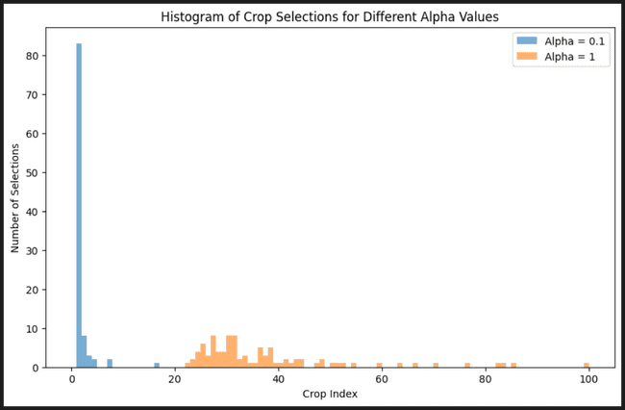
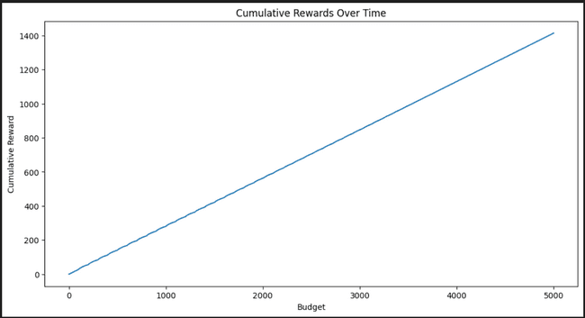
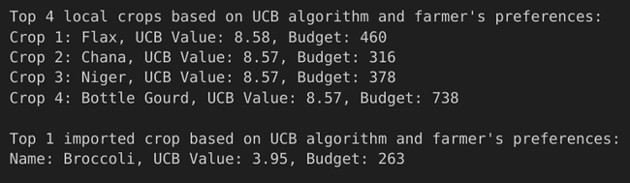
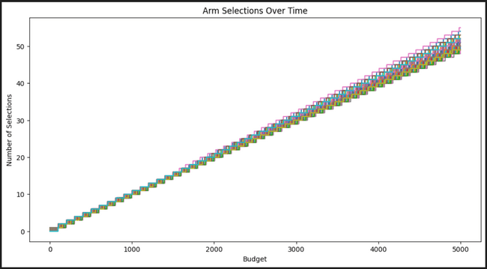
Output Dump 3.0

Slide 30


Yea, thats good, but why not use Deep Learning instead?

Slide 31
Sure
Fetching neurons for you…

Slide 32
Deep Learning

Slide 33
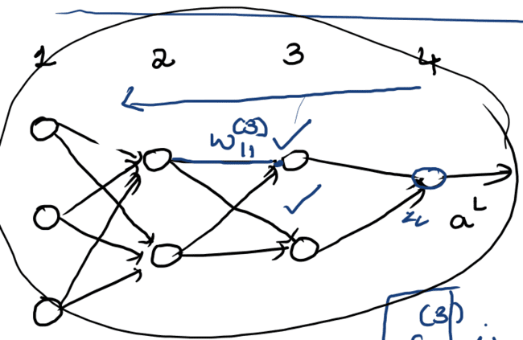
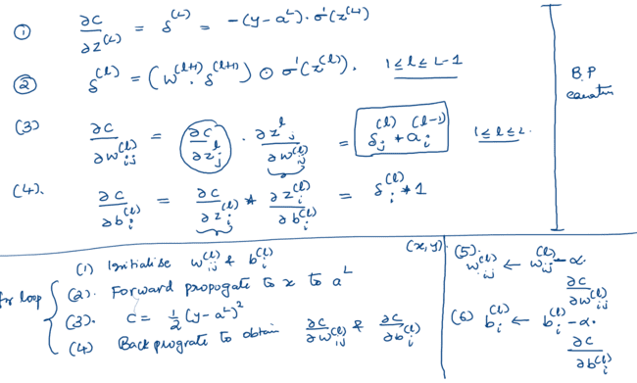
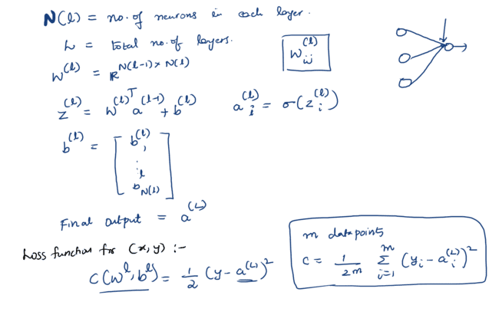
Neural Networks
Ref:. Lecture 11152023 1113 AM
(SEM 1: Machine Learning)

Slide 34
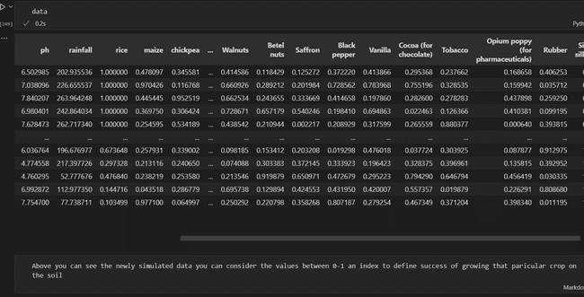
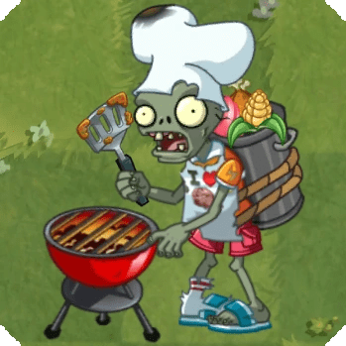
Cooking data

Slide 35
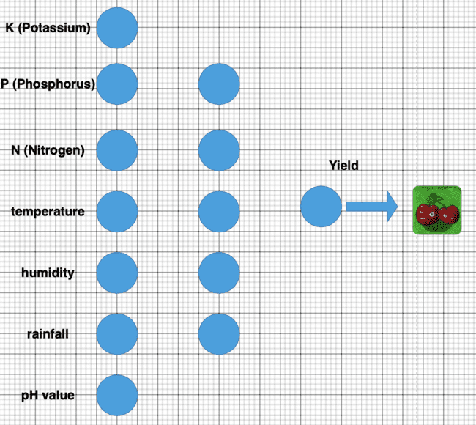
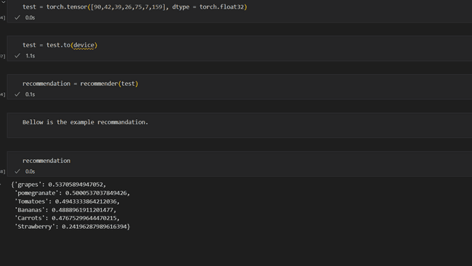

We will predict yield for input crop

Slide 36
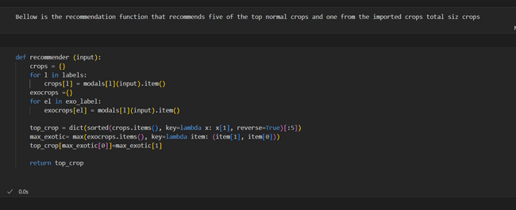

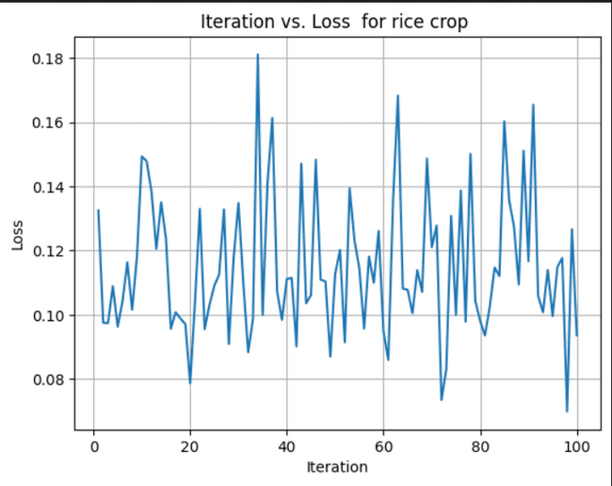
Output dump 3.0

Slide 37

Refrences
All such cool images from
Plants vs Zombies
Class Notes, lectures 9, 12, 14, 15, 16,
( Sem 2: Recommendation System)
Prof. Raghuram Bharadwaj
Class Notes, lecture 11152023 1113 AM
(SEM 1: Machine Learning)
Also by Prof. Raghuram Bharadwaj
Interquartile Range (IQR) - Statistics By Jim
https://statisticsbyjim.com/basics/interquartile-range
Crop Recommendation Dataset by Atharva Ingle
https://www.kaggle.com/datasets/atharvaingle/crop-recommendation-dataset
Crop Rotations by Rodale Institute
https://rodaleinstitute.org/why-organic/organic-farming-practices/crop-rotations/

Slide 38
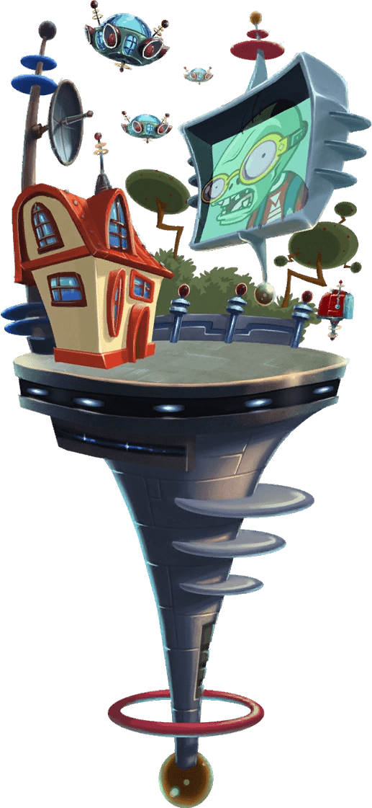
Future Scope
Trying out GCN (graph convolutional network) model, the indisputable leader in crop recommendation tasks.
Recommending pesticides and insecticides along with crops.
Predicting crop demand in prior to tackle problem of crop scarcity.
Using Law of large numbers, to show that more the farmers preferences are sampled from normal distribution, expected mean will go to true mean.
Rather than using content based we can use neural networks as a base to bandits.
There are endless possibilities!!!!

Slide 39
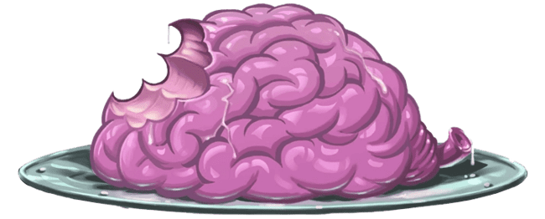
Thank you

